Slide 1

CONSUMER GOODS
AD-HOC INSIGHTS
ATLIQ HARDWARES
Presented By Yashas PS

Slide 2
Objectives
Atliq Hardware, a fictional corporation, stands out as a major computer hardware manufacturer in India and has a robust global presence.
Despite its prominence, the management recognizes a need for more timely and informed decisions backed by data insights.
There's a strategic initiative to enhance the data analytics team by onboarding junior data analysts.
In order to evaluate potential candidates comprehensively, Tony Sharma, the Director of Data Analytics, plans to organize a SQL challenge. This challenge will assess both technical skills and soft skills.
The company has identified 10 specific ad hoc requests for which they are seeking valuable insights.

Slide 3
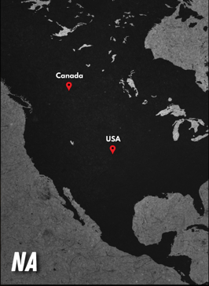
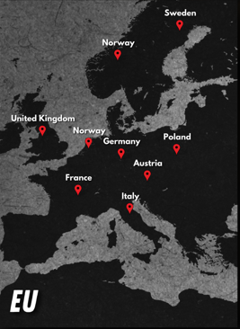

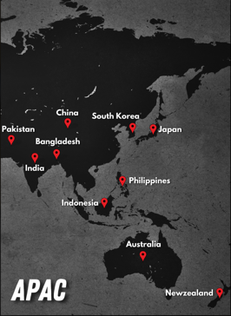
Atliq Hardawares Market

Slide 4
Atliq Hardawares Product Line
Graphic Card
Business Laptop
Desktop
Peripherals
Internal HDD
Personal Laptop
Motherboard
Processors
Gaming Laptop
Batteries
Business Laptop
Notebook
Accessories
Keyboard
Personal Laptop
Mouse
PC
P&A
N&S
Networking
Wi-Fi Extender
Storage
External SSD
USB Flash Drives

Slide 5
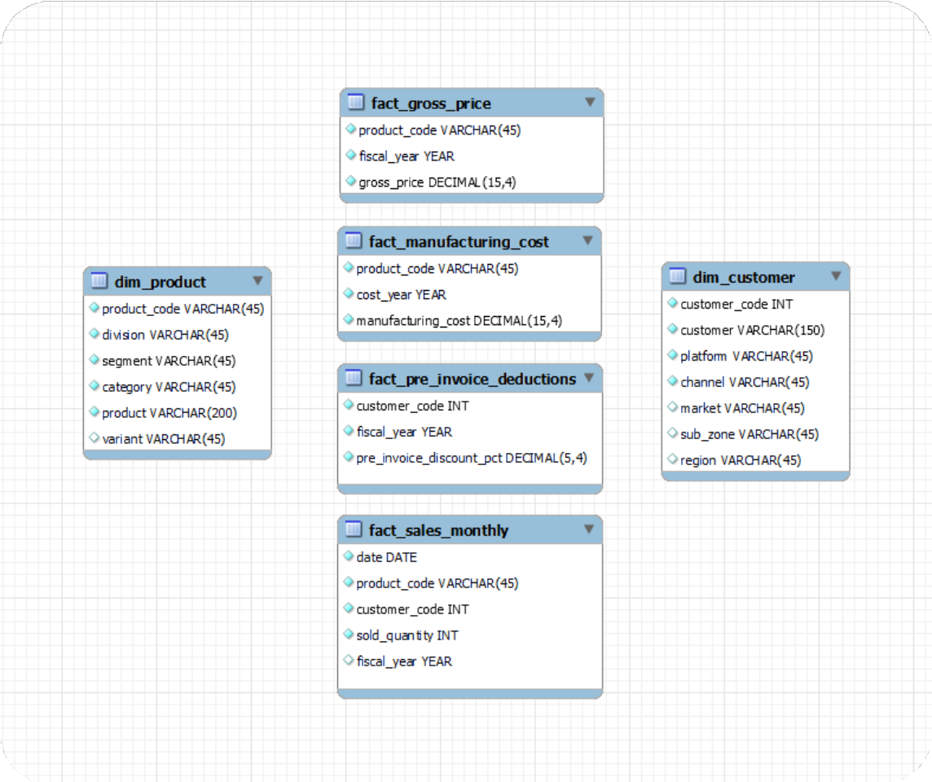
INPUT DATA
The input dataset comprises sales information for the fiscal years 2020 and 2021, complemented by various dimension tables such as customer details, product details, and more.

Slide 6

AD-HOC REQUESTS ALONG WITH THE
QUERIED RESULTS VISUALIZATIONS INSIGHTS

Slide 7
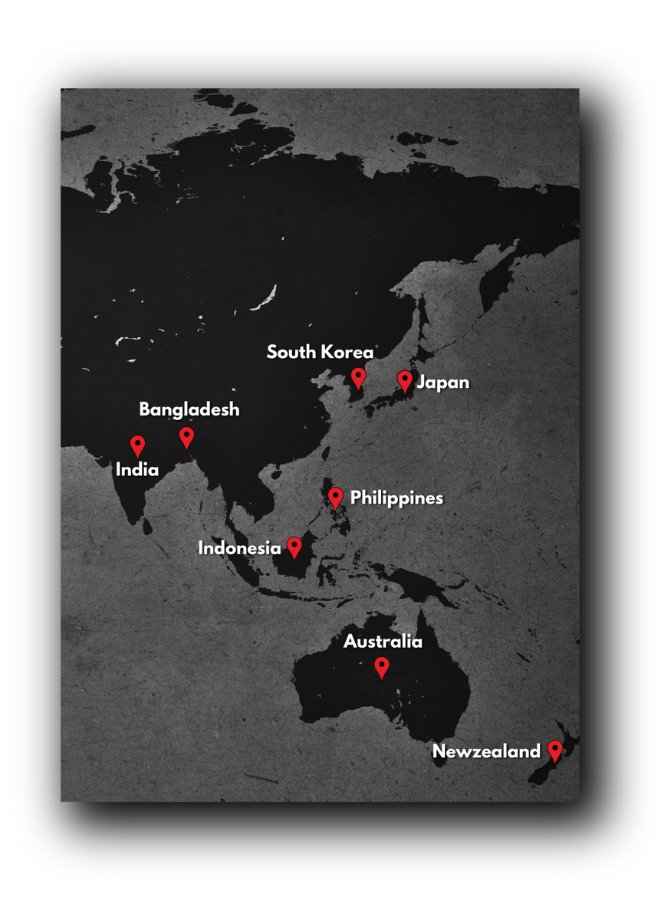
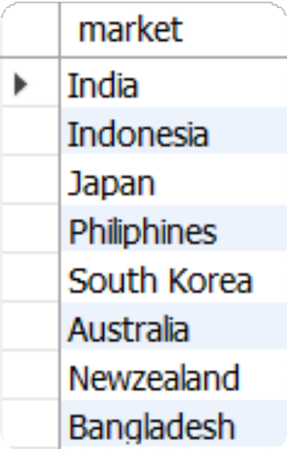
INSIGHTS Provide the list of markets in which customer "Atliq Exclusive" operates its business in the APAC region.
OUTPUT
INSIGHTS
Atliq Exclusive has established a presence in eight key markets within the APAC region.

Slide 8
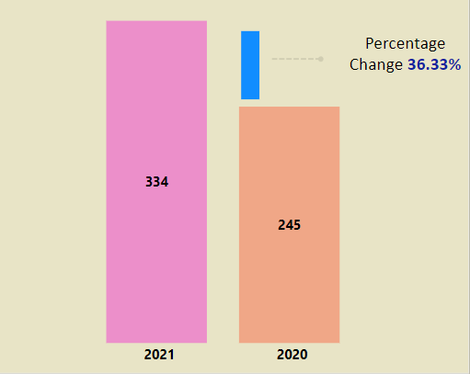
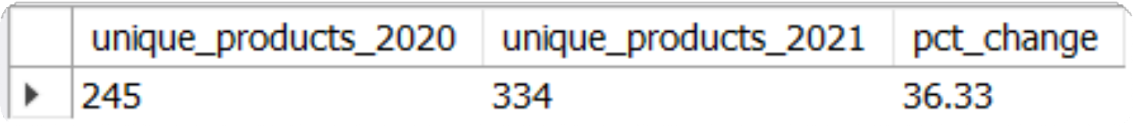
REQUEST 2
What is the percentage of unique product increase in 2021 vs. 2020? The final output contains these fields,
unique_products_2020 unique_products_2021 percentage_chg
OUTPUT
INSIGHTS
In FY 2020, we had a total of 245 products, and in FY 2021, the number increased to 334, reflecting a 36% growth.

Slide 9
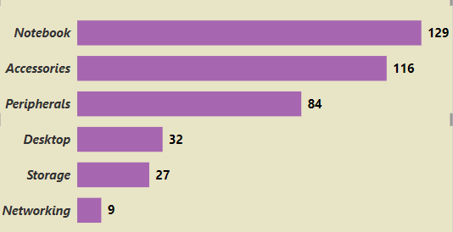
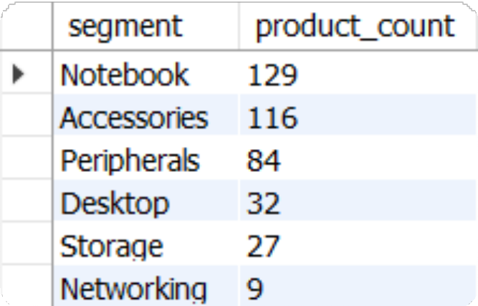
REQUEST 3
Provide a report with all the unique product counts for each segment and sort them in descending order of product counts. The final output contains 2 fields,
segment
product count
OUTPUT
INSIGHTS
Atliq Hardware presents an extensive array of products across the Notebook, Peripherals, and Accessories sectors.
There is a strategic need to broaden the product portfolio within the desktop, networking, and storage markets.
To address this, Atliq Hardware has the opportunity to introduce Trending Products in these specific markets.

Slide 10
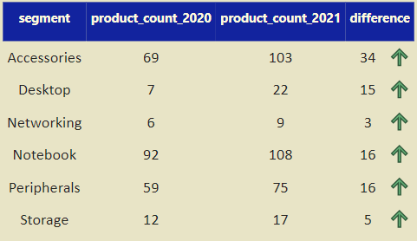
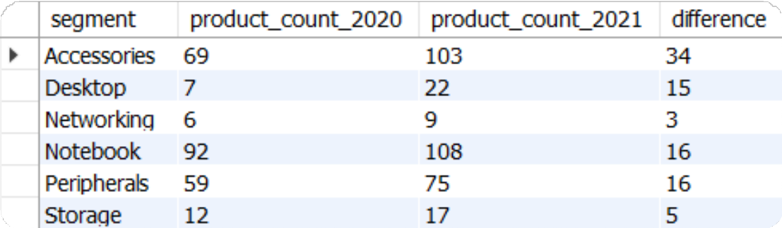
REQUEST 4
Which segment had the most increase in unique products in 2021 vs 2020? The final output contains these fields,
segment,
product_count_2020,
product_count_2021,
difference
OUTPUT
INSIGHTS In 2021, Atliq Hardware primarily focused on expanding its presence in the accessories market, introducing a total of 34 new accessory products to the market.

Slide 11
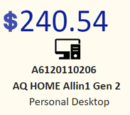

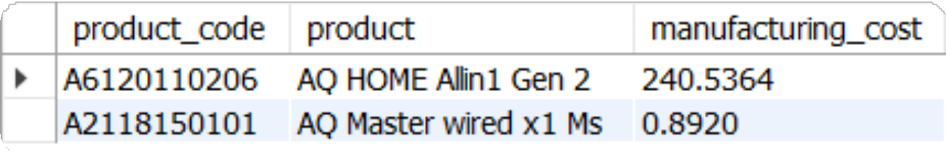
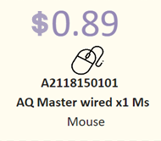

REQUEST 5
Get the products that have the highest and lowest manufacturing costs. The final output should contain these fields,
product_code product manufacturing_cost
Highest Manufacturing
Cost Product
OUTPUT
Lowest Manufacturing
Cost Product

Slide 12
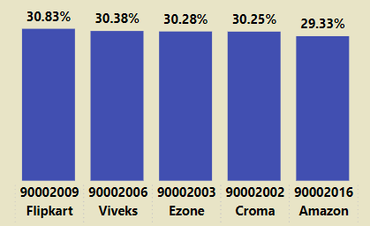
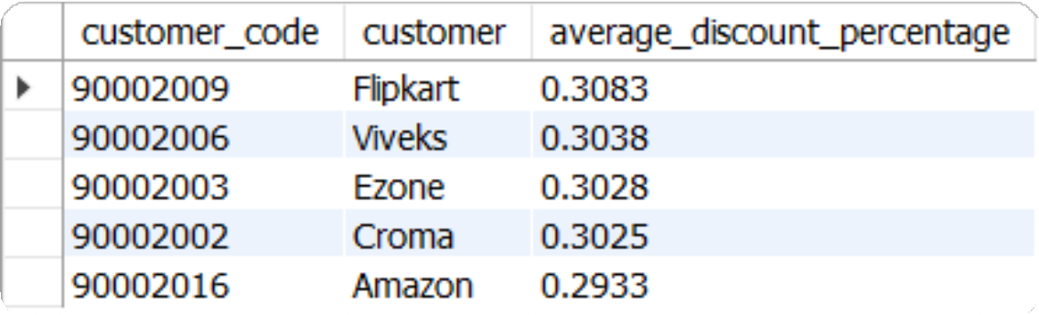
REQUEST 6
Generate a report which contains the top 5 customers who received an average high pre_invoice_discount_pct for the fiscal year 2021 and in the Indian market. The final output contains these fields,
customer code customer
average_discount_percentage
OUTPUT
INSIGHTS
Considering Flipkart holds the position of the most heavily discounted customer in the Indian market, with a pre-invoice discount percentage of 30.83%, Atliq extended approximately similar pre-invoice discount percentages to each of its top 5 clients in 2021.

Slide 13
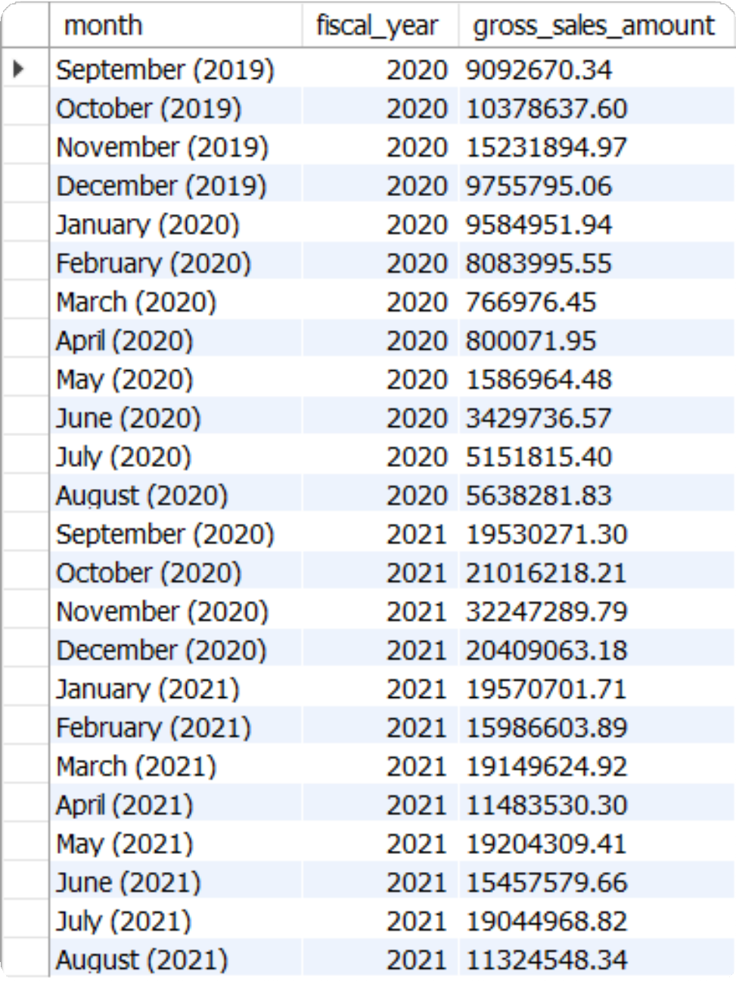
REQUEST 7
Get the complete report of the Gross sales amount for the customer “Atliq Exclusive” for each month . This analysis helps to get an idea of low and high-performing months and take strategic decisions. The final report contains these columns:
Month,
Year,
Gross Sales Amount
OUTPUT

Slide 14
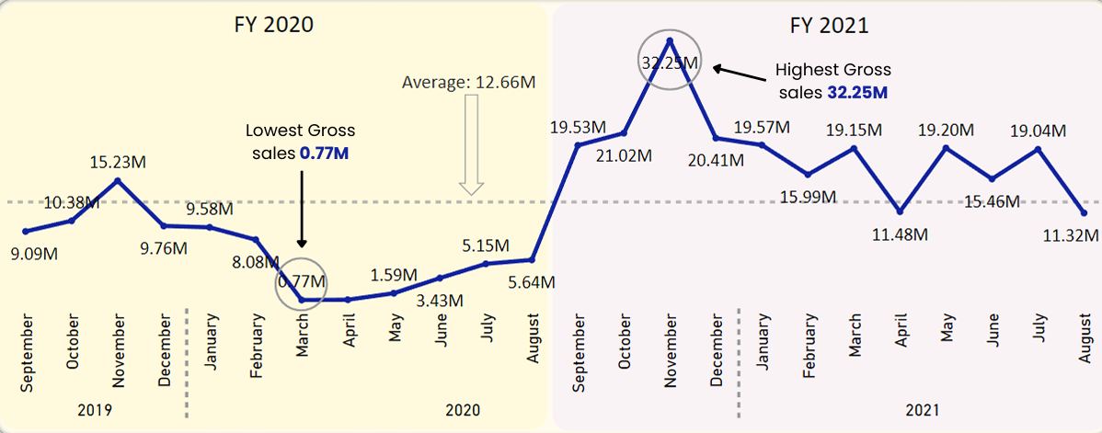
INSIGHTS
Atliq Exclusive experienced its highest sales in November 2020, whereas March 2020 recorded the lowest sales.
The decline in sales between March and August can be attributed to the impact of COVID-19. However, there is optimism as sales have consistently rebounded since the pandemic, remaining robust and surpassing the levels seen in 2020.

Slide 15
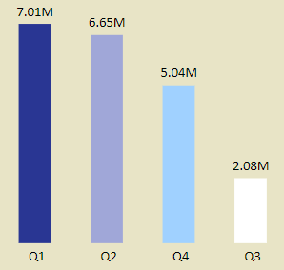
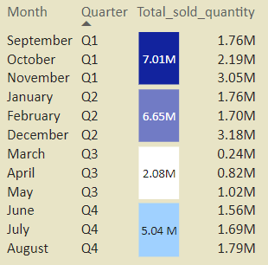
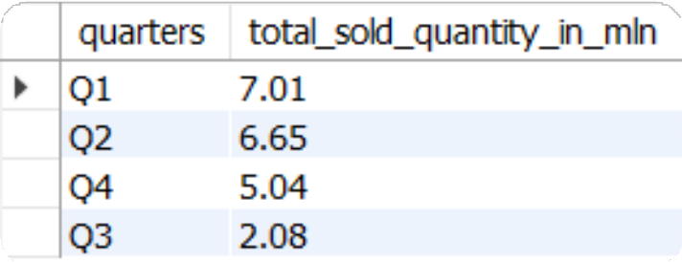
REQUEST 8
In which quarter of 2020, got the maximum total_sold_quantity? The final output contains these fields sorted by the total_sold_quantity,
quarters total_sold_quantity
OUTPUT
INSIGHTS
In the third quarter of fiscal year 2020 (March, April, and May), marked by the peak of COVID-19 and widespread lockdowns impacting businesses, the sold quantity plummeted to 2.1 million.
Notably, there was a significant demand for computer accessories during this period as a large number of students commenced or persisted in completing their coursework online. This heightened demand likely contributed to the early rebound observed in the fourth quarter.

Slide 16
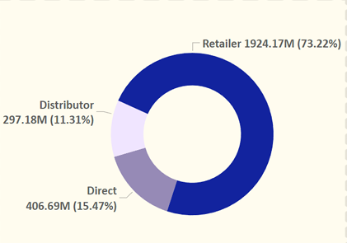
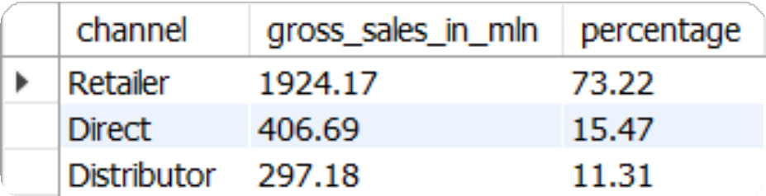
REQUEST 9
Which channel helped to bring more gross sales in the fiscal year 2021 and the percentage of contribution? The final output contains these fields,
channel, gross_sales_mln, percentage
OUTPUT
INSIGHTS
A substantial 73% of Atliq's total sales were conducted through retailers, constituting the majority of its overall sales. In contrast, sales through direct and distributor channels made up a comparatively modest portion of the total revenue.

Slide 17
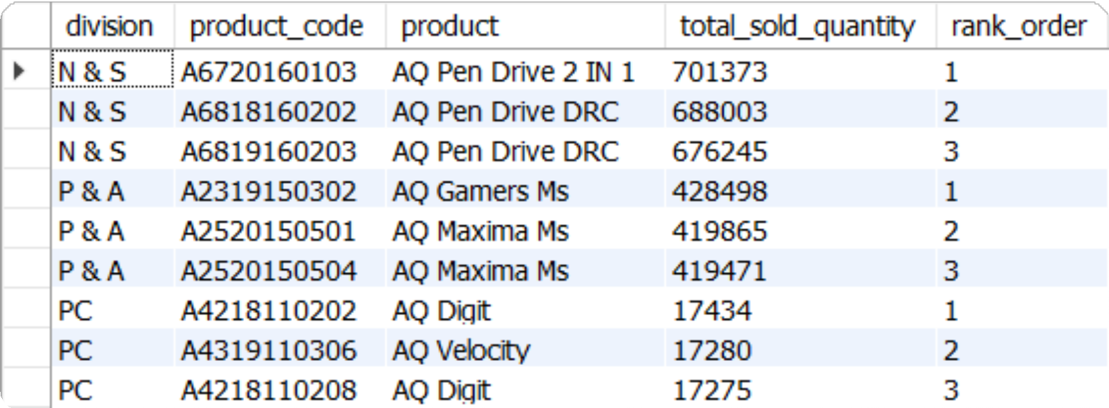
REQUEST 10
Get the Top 3 products in each division that have a high total_sold_quantity in the fiscal_year 2021? The final output contains these fields,
division product_code product total_sold_quantity rank_order
OUTPUT

Slide 18
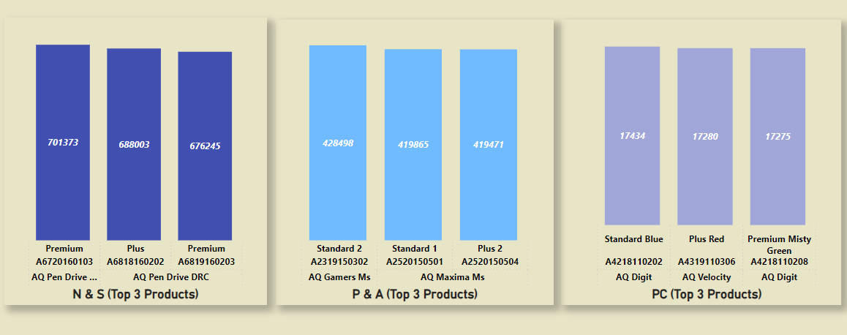
The three best-selling products in the N & S division were pen drives.
The three best-selling products in the P & A division were pen mouse.
The three best-selling products in the PC division were laptops.

Slide 19
Recommendations for enhancing Atliq's sales performance
Provide excellent customer service and build lasting relationships.
Implement an effective marketing strategy across various channels.
Develop a strong brand identity and communicate your unique value.
Invest in sales team training for improved performance.
Offer competitive pricing and attractive promotions.
Enhance your product offerings to meet market demands.
Gather customer feedback to continuously improve.

Slide 20
THANK YOU!
HOW TO REACH ME?
Mail -- yashasyash44@gmail.com
Yashas P S

